Slide 1
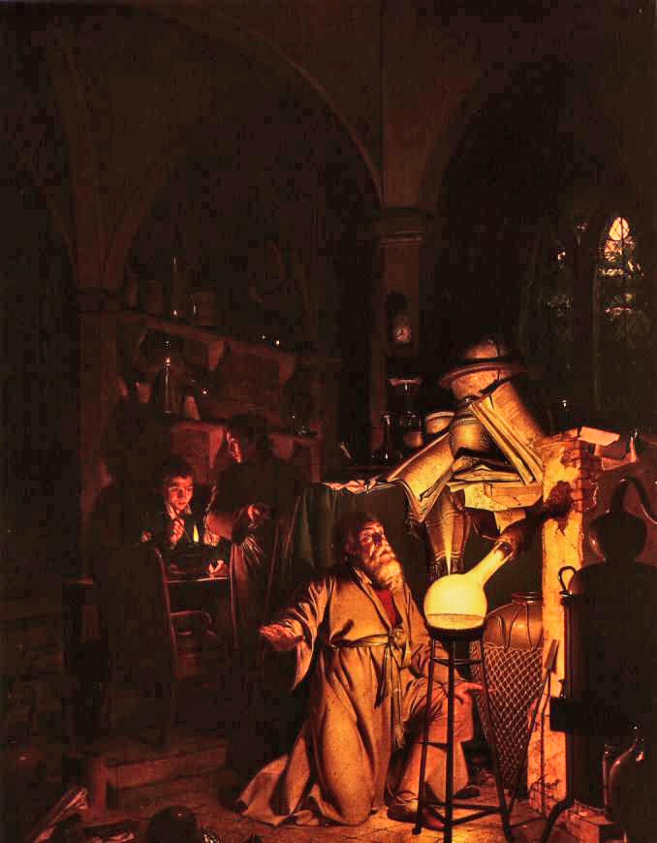
“Perovskite” Photovoltaics
SUNLAB Journal Club
J.P.D. Cook
140626
“The Alchymist, in Search of the Philosopher's Stone, Discovers Phosphorus, and prays for the successful Conclusion of his operation, as was the custom of the Ancient Chymical Astrologers”
Joseph Wright, Derby UK, 1771

Slide 2
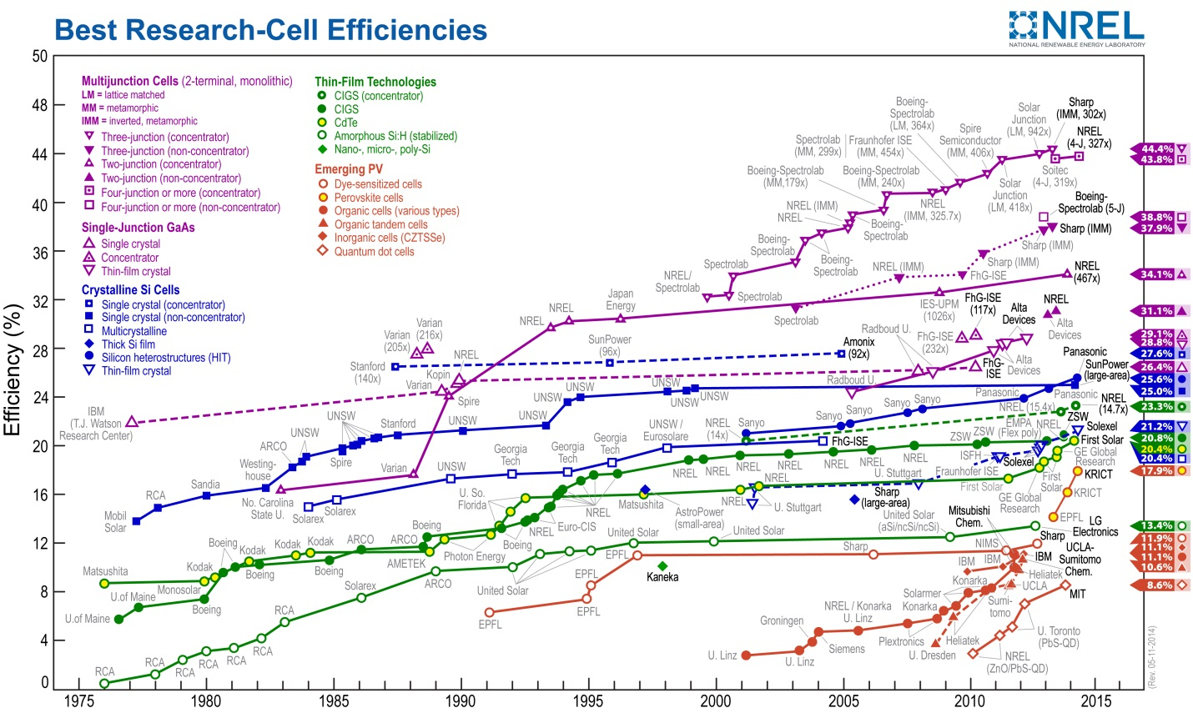
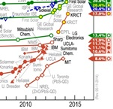
NREL Hero Chart

Slide 3
Recent Heroes
Previously 10-12% 1995-2010... Then …
15% published 2013: EPFL Grätzel
“Sequential deposition as a route to high-performance perovskite-sensitized solar cells” Nature 499, 316–319 (18 July 2013) doi:10.1038/nature12340
16.2% NREL test 2013: KRICT
Science News editorial: runner-up Breakthrough of the Year, Science, 2013, 342, 1438-1439
17.9% published 2014: KRICT
“Voltage Output of Efficient Perovskite Solar Cells with high Open-Circuit Voltage and Fill Factor” Energy Environ. Sci., 2014, DOI:10.1039/C4EE00762J
19.3% claimed 2014 Spring MRS: UCLA Yang

Slide 4
Review Articles
P.P. Boix, K. Nonomura, N. Mathews, S.G. Mhaisalkar (various Singapore institutions)
“Current progress and future perspectives for organic/inorganic perovskite solar cells” Materials Today 17(1)(2014)16
http://dx.doi.org/10.1016/j.mattod.2013.12.002
P. Docampo , S. Guldin , T. Leijtens , N.K. Noel , U. Steiner , H.J. Snaith (Oxford)
“Lessons Learned: From Dye-Sensitized Solar Cells to All-Solid-State Hybrid Devices” Advanced Materials (2014)
http://dx.doi.org/10.1002/adma.201400486
Plus a literature of over 200 articles to date, of which several dozen 2014

Slide 5
“Perovskites”
Not a particularly helpful term; like saying most active optoelectronic devices are done with “zincblende” or “wurtzite” materials
Large research field over decades: transistors, displays, photoconversion, transducers (magnetic effects), superconductivity, colossal magnetoresistance (Mn-containing), surface acoustic wave (SAW) devices, and now photovoltaics.
Perovskites have also been investigated in the context of fuel cells (photocatalytic decomposition of water to H₂ and O₂) but their composition is much different from PV materials.

Slide 6
Perovskites (2)
More recently, organic-inorganic perovskite compounds have become interesting.
Perovskite PV is actually an outgrowth of dye-sensitized solar cells (DSSC) research (also called Grätzel cells after Michael Grätzel ...)
DSSC advantages: accessible processes. weaknesses:
  Dye in solution – freeze/thaw, leaks
  Best efficiency ~ low double digits

Slide 7
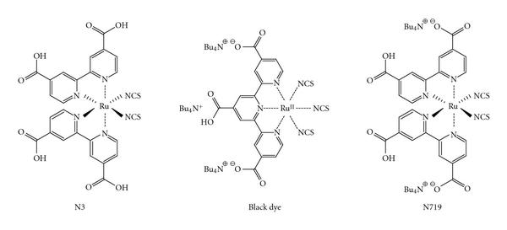
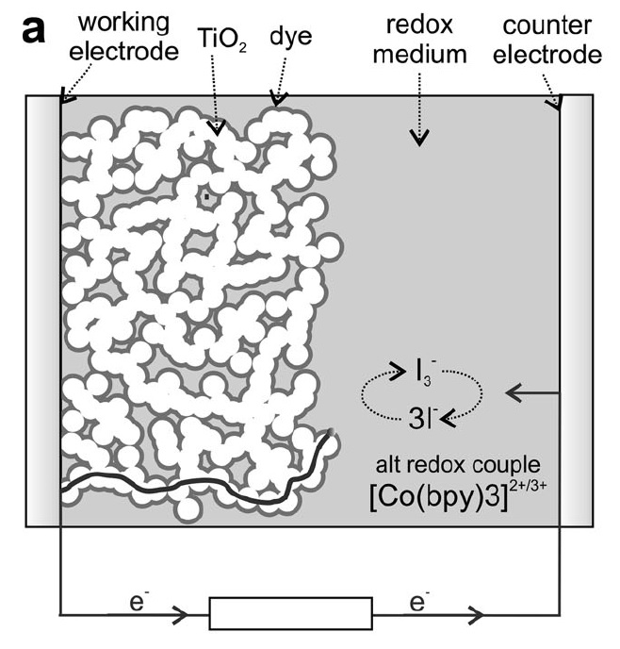
History
vs bulk in III-V MJPV
DSSC: Photons are absorbed
in a very thin dye layer
  Exotic dye molecules: e.g. triscarboxy-ruthenium terpyridine; Ru(4,40-dicarboxy-2,20-bipyridine)₂(NCS)₂
  Supported on a scaffold of mesoporous TiO₂ which extracts electrons to transparent front conductive window electrode
  Immersed in a hole transport fluid connected to rear electrode
optically transparent F:SnO₂

Slide 8
History (2)
Breakthru 2009: CH₃NH₃PbI₃ in solution
Miyasaki et al (Tokyo) JACS 131(2009)6050
doi: 10.1021/ja809598r
Breakthru 2012: Solid CH₃NH₃PbI₃
HS Kim et al (Korea)
Scientific Reports 2(2012)1
MM Lee Science 338(2012)643
Clue: perovskite OILEDs 1999
“Electroluminescence from an Organic-Inorganic Perovskite Incorporating a Quaterthiophene Dye within Lead Halide Perovskite Layers”
Chondroudis & Mitzi (IBM Yorktown Heights) Chem. Mater. 1999, 11, 3028-3030
“Comparative study on the excitons of lead-halide based perovskites CH₃NH₃PbI₃ and CH₃NH₃PbBr₃” Tanaka et al, Solid State Comm. 127(2003)619
How would one come up with such a funky material???

Slide 9
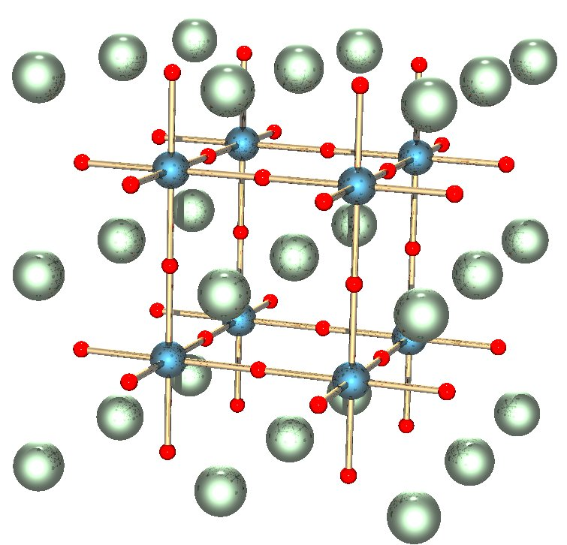
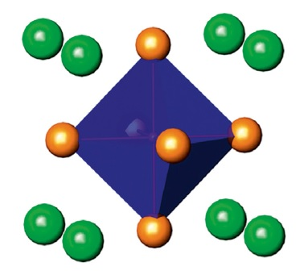
Perovskites (3)
Stoichiometry: ABO₃ or ABX₃
where A = larger? species; B = smaller? species; X = halide
First perovskite (1857) was CaTiO₃. (LiNbO₃ has stoichiometry, but is trigonal.)
Space group P_{4mm}

Slide 10
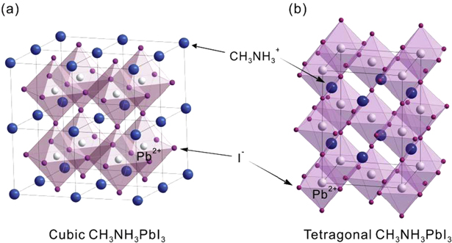
Perovskites (4)
Perovskite PV sensitizers are RMX₃
where R = organic; M = metal; X = halide (Cl, Br, I)

Slide 11
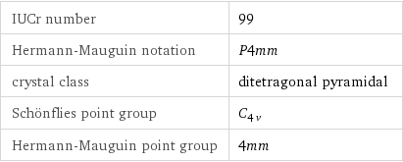
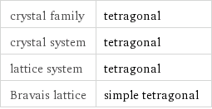
Perovskites (5)
P_{4mm}
Summary:
Crystallographic properties:

Slide 12
History (3)
Architectures: “injecting” vs “non-injecting”
  Injecting: electrons injected into the mesoporous TiO₂, then percolate out to electrode
  Non-injecting: electrons extracted through the sensitizer, out to electrode (Al₂O₃, ZrO₂)

Slide 13
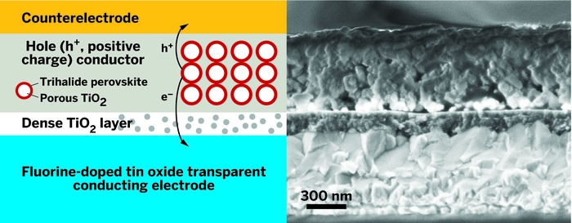
History (4)
Discard solutions; completely solid-state device

Slide 14
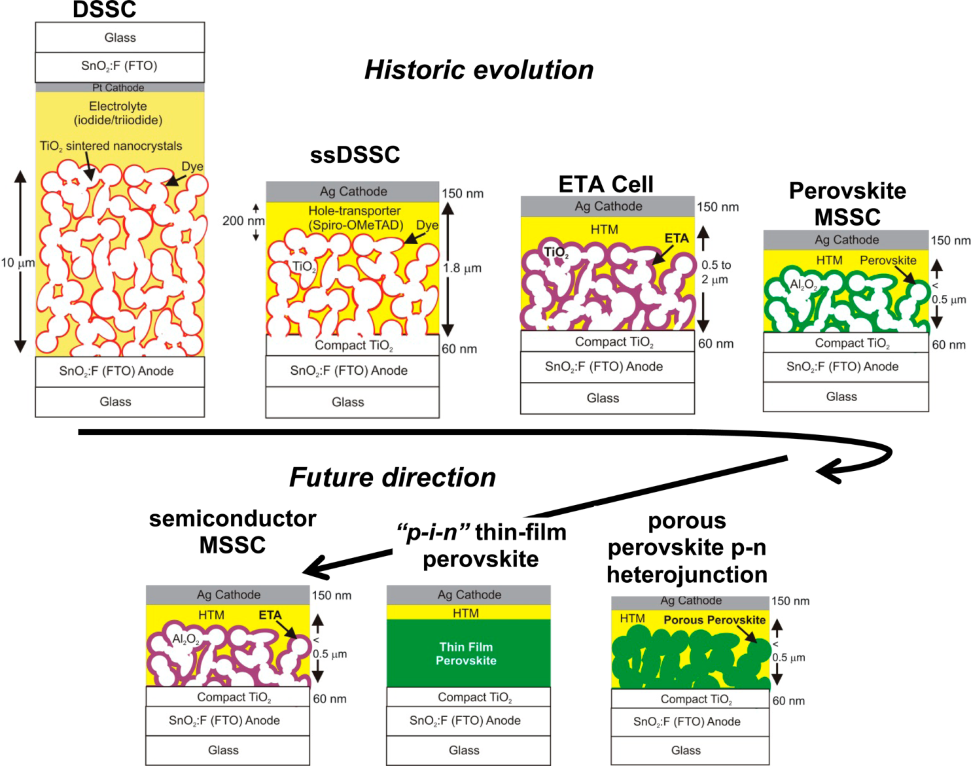
History (5)
“Perovskites: The Emergence of a New Era for Low-Cost, High-Efficiency Solar Cells”
HJ Snaith dx.doi.org/10.1021/jz4020162
J. Phys. Chem. Lett. 2013, 4, 3623-3630
Figure 4. Historic evolution of the solar cell technology, starting from the electrolyte-based mesoscopic DSSC, the ssDSSC where the electrolyte is replaced with an organic p-type hole conductor, the ETA cell where the dye is replaced with an ETA semiconductor layer, to the MSSC, where the ETA is replaced with a perovskite absorber and the n-type TiO₂ is replaced with a porous insulating scaffold. Three likely future directions for the perovskite technology are indicated: (i) porous perovskite distributed p-n heterojunction solar cells, where the Al₂O₃ is removed but the perovskite is directly structured to give a porous film subsequently filled in with a charge conductor, (ii) thin-film p-i-n perovskite solar cells where no porosity is required and the device takes on the structure of an intrinsic, or at least ambipolar, thin perovskite film sandwiched between p- and n-type charge-extracting contacts, or (iii) semiconductor MSSCs, where any solution-processed semiconductor, such as SbS, can be structured by the porous scaffold to deliver a MSSC.

Slide 15
Mat Props
material | Lattice space/point group | m.p. [K] | bandgap [eV] | LUMO HOMO [eV] | p-dopants n-dopants | extinction coeff | exciton B.E. [meV] | carrier lifetime | carrier diff length [nm] | CTE [ppm/K] | k [Wm⁻¹K⁻¹] | NRR mechanisms | n
Si | diamond | 1800 | indirect 1.11 |  |  |  | 14.7 |  |  | 5.4 | 149
Ge | diamond | 1211 | direct 0.67 |  |  |  | 1.5 |  |  | 5.8 | 60
SiGe
SiC | various |  |  |  |  |  | 27
GaAs | zinc blende |  | direct 1.43 |  | B Zn … Ge … |  | 4.2 |  |  | 6.86 | 46 | TD, surface, grain b
InP | zinc blende | 1335 | direct 1.34 |  |  |  | 4 |  |  | 6.3 | 68
GaN | wurtzite |  | direct 3.4 |  |  |  | 27 |  |  | 13.4 | 230 |  | 2.4
(CH₃NH₃)PbI₃ | perovskite P_{4mm}/? |  | direct 1.55 | -3.93 -5.43 |  | 1.5 × 10⁴ cm⁻¹ @ 550 nm (10X) | 50 |  | e 130 h 100
(CH(NH₂)₂)PbI₃ Formamidinium | perovskite |  | direct 1.43
CH₃NH₃PbI_{3-x}Cl_{x} | perovskite |  | direct 1.55 |  |  |  |  |  | e 1000 h 1200
CH₃NH₃PbBr₃ | perovskite |  | direct 2.2 | -4.3 -6.5 |  |  | 76
CsSnI₃ | perovskite 4 polymorphs |  | direct 1.3 |  |  |  | 18
CdTe | zincblende F43m |  | direct 1.44 |  |  |  | 10.6

Slide 16
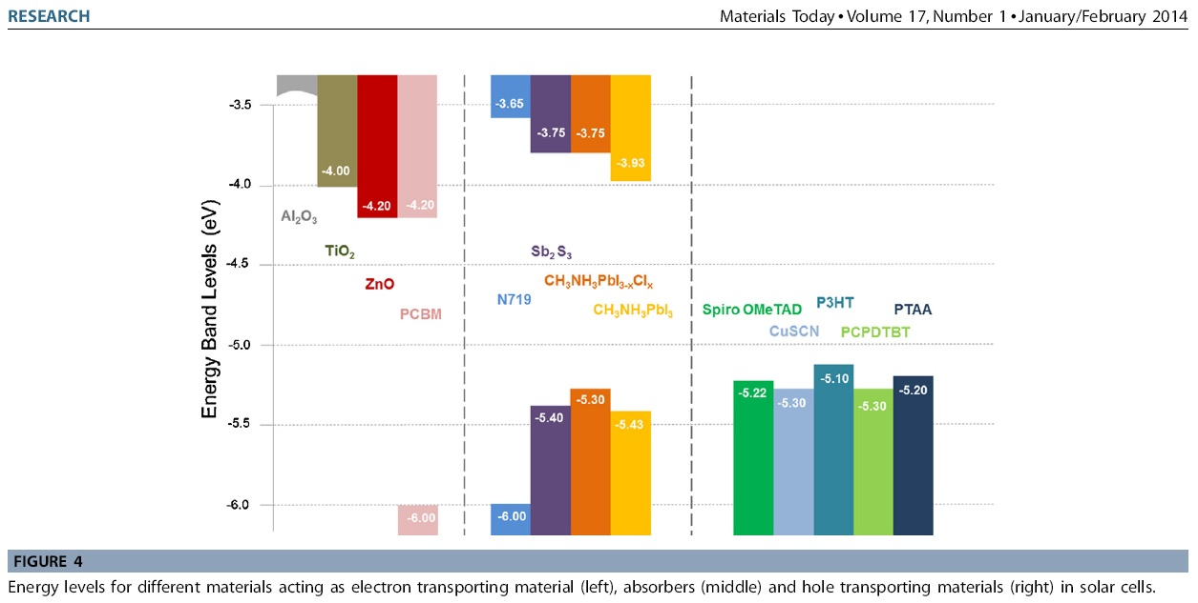
Band Structure
Optimum single-subcell bandgap ~1.4eV

Slide 17
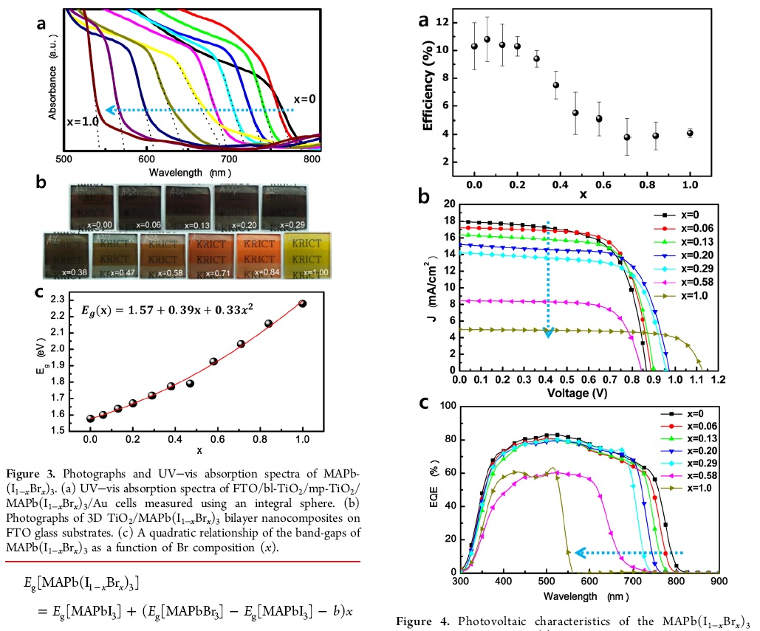
Band Structure (2)
Chemical Management for Colorful, Efficient, and Stable Inorganic–Organic Hybrid Nanostructured Solar Cells
JH Noh, SH Im, JH Heo,
TN Mandal, SI Seok (Korea)
Nano Lett., 2013, 13 (4), 1764–1769
DOI: 10.1021/nl400349b

Slide 18
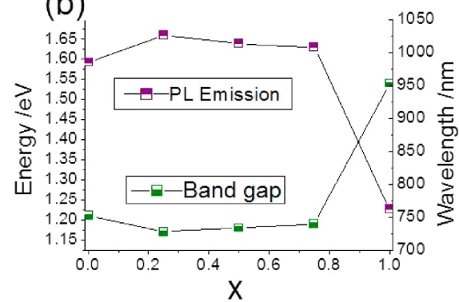
Band Structure (3)
“Tuning the Band Gap in Hybrid Tin Iodide Perovskite Semiconductors Using Structural Templating”
JL Knutson, JD Martin, DB Mitzi Inorg. Chem., 2005, 44 (13), 4699–4705
DOI: 10.1021/ic050244q
Papavassiliou et al “Some New Organic–Inorganic Hybrid Semiconductors Based on Metal Halide Units: Structural, Optical and Related Properties”
Adv. Mater. Opt. Electron. 9(1999)265
Stoumpos et al “Semiconducting Tin and Lead Iodide Perovskites with Organic Cations: Phase Transitions, High Mobilities, and Near-Infrared Photoluminescent Properties”
Inorg. Chem. 52(2013)9019
dx.doi.org/10.1021/ic401215x
bandgap of CH₃NH₃(Sn_{1-x}Pb_{x})I₃

Slide 19
Conduction Mechanisms
& Testing
e-h pair creation in perovskite
  Mott-Wannier exciton: binding energy 50meV (I₃) 76meV (Br₃)
  Tanaka et al, Solid State Comm. 127(2003)619
NRR in perovskite (bulk, defect, surface, interface)
Injection into electron transport material (ETM)
Injection into hole transport material (HTM)
Conduction through ETM
Conduction through HTM
Transfer to electrodes (barriers, etc.)
Series resistances, voltage barriers, …
Instabilities
  Cell load and electrolyte response time
  Hysteresis, inversely (!) proportional to I-V scan rate

Slide 20
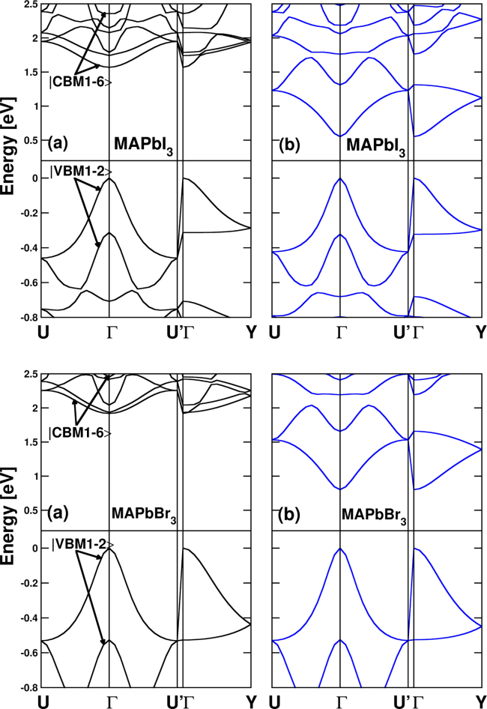
Modeling
“First-Principles Modeling of Mixed Halide Organometal Perovskites for Photovoltaic Applications” E Mosconi, A Amat, MK Nazeeruddin, M Grätzel, and F De Angelis
dx.doi.org/10.1021/jp4048659 J. Phys. Chem. C 2013, 117, 13902-13913
“Modeling of Lead Halide Perovskites for Photovoltaic Applications” RA Jishi, OB Ta, AA Sharif, UCLA, arXiv May 22, 2014
“Ferroelectric contributions to anomalous hysteresis
in hybrid perovskite solar cells” JM Frost, KT Butler,
and A Walsh, uBath, arXiv May 23, 2014
Giant spin-orbit coupling: “Importance of Spin-Orbit
Coupling in Hybrid Organic/Inorganic Perovskites for
Photovoltaic Applications” J Even … C Katan, dx.doi.org/10.1021/jz401532q
J. Phys. Chem. Lett. 2013, 4, 2999-3005

Slide 21
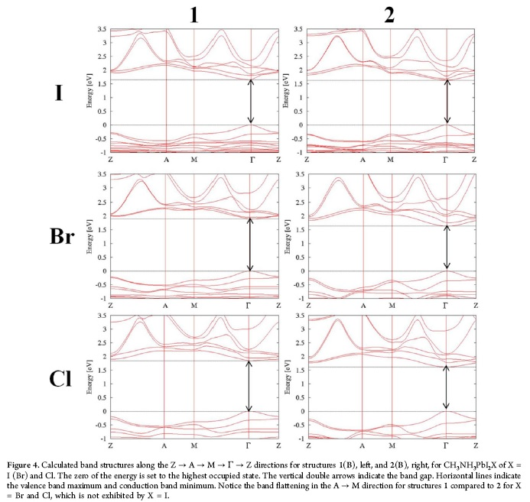
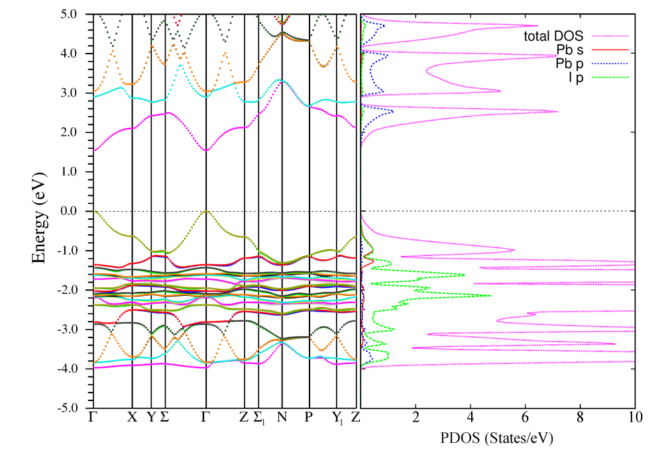
Modeling (2)
“First-Principles Modeling of Mixed Halide Organometal Perovskites for Photovoltaic Applications” E Mosconi, A Amat, MK Nazeeruddin, M Grätzel, and F De Angelis
dx.doi.org/10.1021/jp4048659 J. Phys. Chem. C 2013, 117, 13902-13913
“Modeling of Lead Halide Perovskites for Photovoltaic Applications” RA Jishi, OB Ta, AA Sharif, UCLA, arXiv May 22, 2014

Slide 22
Device Access
Hole transport materials (HTM)
Electron transport materials (ETM)
  TiO₂
  Nanorod TiO₂
Surface passivation
  passivation of TiO₂ with Y₂O₃ DOI:10.1002/cphc.201301153
Ohmic contacts
Substrates

Slide 23
Material Processing
TiO₂: commercial nanopowder
F:SnO₂ window: commercial
Rear electrode: metal on substrate
HTM: presently the most expensive
Perovskite:

Slide 24
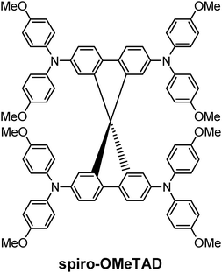
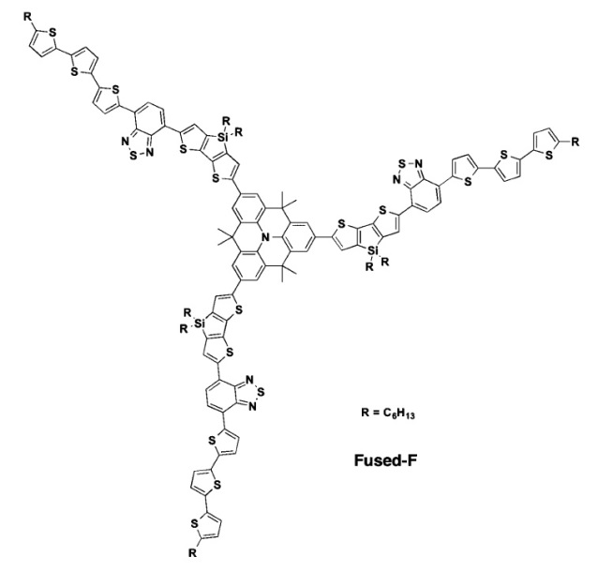
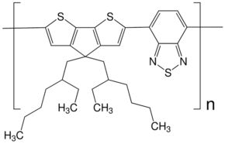
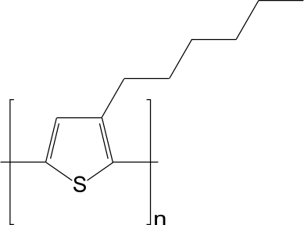
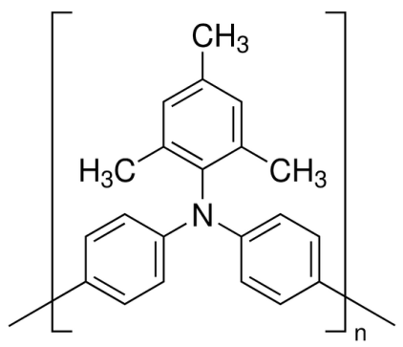
Hole Carrier Materials (HTM)
Spiro-OMeTAD
Copper iodide (CuI): known good hole conductor
Christians et al UND Indiana DOI:10.1021/ja411014k and also DOI:10.1016/j.jssc.2005.07.015
PTAA, P3HT, PCPDTBT
Thiophenes are historical
PTAA
poly[bis(4-phenyl)(2,4,6-trimethylphenyl)amine]

Slide 25
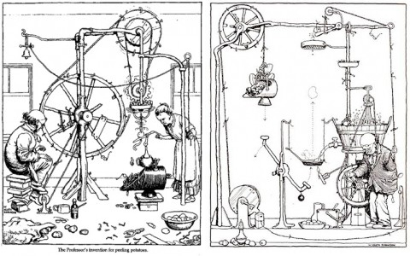
Manufacturability
Perovskite synthesis
  In situ chemical reaction
  CH₃NH₂ + HI → CH₃NH₃I + PbI₂ → CH₃NH₃PbI₃
  Vapour deposition CH₃NH₃I and PbI₂
  Efficient planar heterojunction perovskite solar cells by vapour deposition, Liu et al, Nature 501, 395–398 (2013) doi:10.1038/nature12509
  Epitaxial? (“Digital chemical vapor deposition (CVD) method for forming a multi-component oxide layer” US 5972430 A = oxides, not organo-lead-halides)
“Professor Branestawm’s apparatus for cooking potatoes.”

Slide 26
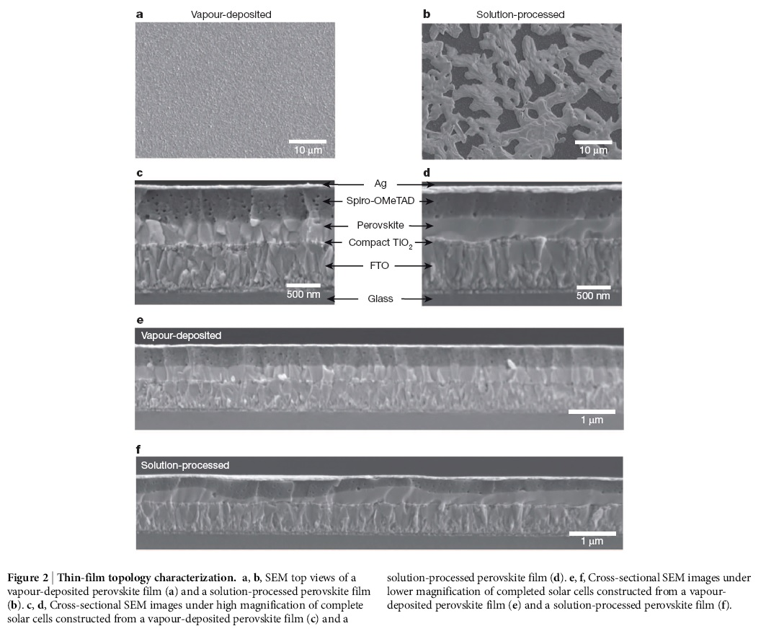
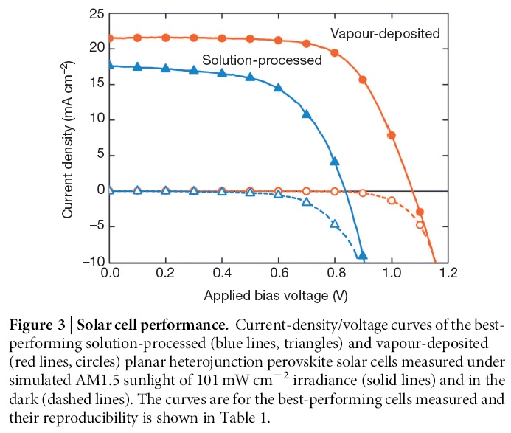
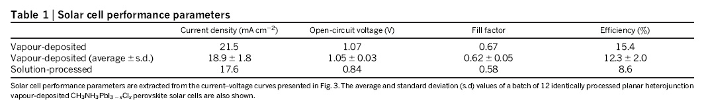
Manufacturability (2)
“Efficient planar heterojunction perovskite solar cells by vapour deposition” Liu et al, Nature 501, 395–398 (2013) doi:10.1038/nature12509

Slide 27

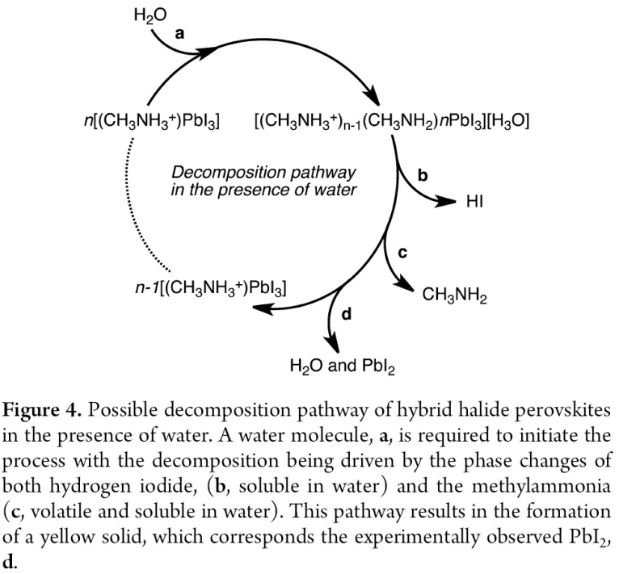
Reliability
CH₃NH₃PbI₃ degrades with moisture
J.H. Noh et al. Nano Letters 13 (2013) 1764
Zhao et al 2014 http://dx.doi.org/10.1039/C3CC48522F
"Atomistic Origins of High-Performance
in Hybrid Halide Perovskite Solar Cells",
Frost et al, Nano Letters Jan 2014
UV degradation: in absorber? in TiO₂?
(CH₃NH₃)PbI₃ is not stable (with color bleaching) in polar solvents or in solutions containing high iodine/iodide concentrations.^{9,20} Although the exact mechanism underlying this stability issue is unclear, the reported color bleaching for (CH₃NH₃)PbI₃ is irreversible. The (CH₃NH₃)PbI₃ film changes its color from brown to yellow when exposed to water, and cannot turn back from yellow to brown after the removal of water. In this study, we show that the NH₃ gas induces a phase transformation of the perovskite (CH₃NH₃)PbI₃ film, leading to a rapid (<1 s) change in its color from brown to transparent across the entire visible spectral range. This color change is reversed within seconds upon removing the NH₃ gas

Slide 28
Regulatory
Pb content from RPbX₃
  ROHS: Fixed Installation?
  CdTe?

Slide 29
Ownership
Patent survey:

Slide 30
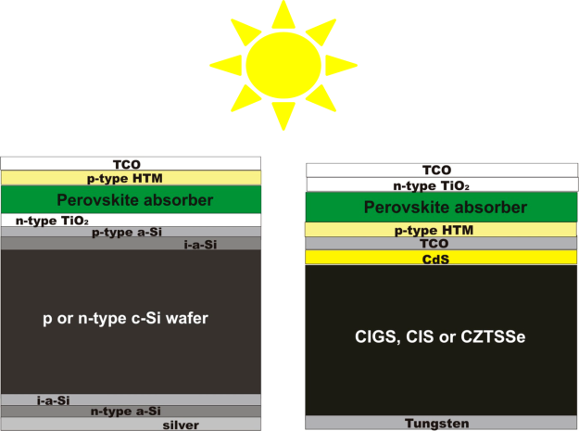
Future & Uninvestigated
Tandem structures
Drop TiO₂, HTMs; deposit MAPbI₃ on metal substrate and coat with transparent conductor?
“Perovskites: The Emergence of a New Era for Low-Cost, High-Efficiency Solar Cells” HJ Snaith
dx.doi.org/10.1021/jz4020162 J. Phys. Chem. Lett. 2013, 4, 3623-3630
True multijunction: progressive bandgap; TJ equivalent
Performance under concentration

Slide 31
Summary
Pro
  ? Less expensive polycrystalline materials & processes
  Liquid phase eliminated
Con
  Organic group instability
  ? Pb (RoHS)
  ? Large exciton binding energy
  ? Electrical instability

Slide 32
Reading List
“Current progress and future perspectives for organic/inorganic perovskite solar cells” Materials Today 17(1)(2014)16
http://dx.doi.org/10.1016/j.mattod.2013.12.002
“Lessons Learned: From Dye-Sensitized Solar Cells to All-Solid-State Hybrid Devices” Advanced Materials (2014)
http://dx.doi.org/10.1002/adma.201400486
“Organolead Halide Perovskite: New Horizons in Solar Cell Research” dx.doi.org/10.1021/jp409025w J. Phys. Chem. C 2014, 118, 5615-5625
“Voltage Output of Efficient Perovskite Solar Cells with high Open-Circuit Voltage and Fill Factor” Energy Environ. Sci., 2014, DOI:10.1039/C4EE00762J
“Organic—inorganic hybrid solar cells:A comparative review” M Wright, A Uddin, Solar Energy Materials & Solar Cells 107(2012)87–111
Plus a folder of 250+ literature articles and some news pieces

Slide 33
Journals & Conferences
Journals
  Nature, Nature Communications, Nature Photonics, Nature Materials, Scientific Reports
  (NPG Nature Publishing Group)
  Energy & Env. Sci., Royal Soc. Chem. Adv., J. Mat. Chem. A, Nanoscale, Phys. Chem. & Chem. Phys.
  (RSC Publishing)
  JACS, J. Phys. Chem. C, J. Phys. Chem. Lett. (ACS Publications)
  Science (AAAS)
  Nano, Nano Letters, Nano Energy, Organic Electronics, Mat. Lett. (Elsevier)
  Appl. Phys. Lett. (AIP Publishing LLP)
  Phys. Rev. B (APS)
  Inorg. Chem., Chem. Materials, ACS Nano (ACS Publications)
  Angew. Chem., Advanced Materials, Adv. Functional Materials (Wiley)
  Solid State Comm. (Pergamon)
  arXiv
  (little or nothing in Prog. Photovoltaics)
Conferences
  Photonics for Solar Energy Systems (SPIE)
  Materials Research Society (Session Y: Physics of Organic and Hybrid Organic-Inorganic Solar Cells)
  Hybrid and Organic Photovoltaics http://www.nanoge.org/HOPV14/
  First Conf Perovskite Solar Cells and New Generation Solar Cells (Beijing) http://solar.iphy.ac.cn/meetingen.html

Slide 34
Research Groups
France: EPFL Grätzel
(École Polytechnique Fédérale de Lausanne)
S. Korea: KRICT
(Korea Research Institute of Chemical Technology)
UK: Oxford Snaith
USA: UCLA Yang
USA: Northwestern Kanatzidis
Italy (Perugia): CLHYO
Etc.

Slide 35
Commercialization or, “What could possibly go wrong?”
OxfordPV (Snaith)
Solaronix
DYESOL http://www.dyesol.com/
G24 Innovations http://gcell.com/

Slide 36

Demonstrators
EPFL/Romande Energie: convention centre
  1400 modules; 300m²
  http://actu.epfl.ch/news/epfl-s-campus-has-the-world-s-first-solar-window/

Slide 37
COPTCBPMRR: a word to live by
Cost: development, manufacturing, install, etc.
Ownership: IP ring-fence
Price/Profit: FIT incentives; R&D incentives
Time to market:
Competition:
Brains: brain management, science literature
Performance: solar resource dependence
Manufacturability: fab time, yield, quality
Reliability: outdoor plant, serviceability
Regulatory:
Good – Fast – Cheap
pick any two
Law of Conservation
of Misery
}
“[We] continue to try more to profit from always remembering the obvious than from grasping the esoteric. … It is remarkable how much long-term advantage people like us have gotten by trying to be consistently not stupid, instead of trying to be very intelligent.”
old Berkshire Hathaway shareholder letter,
Charlie Munger VP

Slide 38
Follow-up Questions

Slide 39
Background Charts
Periodic Table
Compound Semiconducto Bandgap Engineering

Slide 40
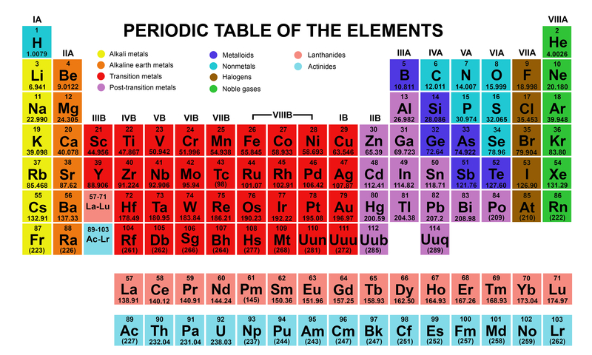
Periodic Table

Slide 41
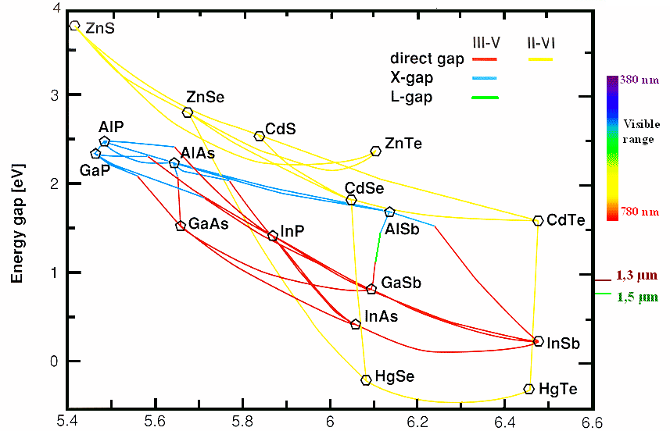
Compound Semiconductor
Bandgap Engineering

